Slide 1


Zero Tolerance
Empowering You to Protect Florida’s
Most Sacred Population
Family Café 2023
Taylor N. Hatch
APD Director

Slide 2

TOPICS TO DISCUSS
About our Agency
Florida Statutes
Abuse, Neglect, and Exploitation
National Statistics
Bullying
Prevention Methods
Reporting and Barriers

Slide 3
About Our Agency
The Agency for Persons with Disabilities (APD) partners with stakeholders, sister agencies, nonprofits, faith-based organizations, parents, providers, private sector partners, and other networks to support people with developmental disabilities in living, learning, and working in their communities.

Slide 4
Zero Tolerance Initiative
APD’s Zero Tolerance Initiative was created as a community effort to combat abuse, neglect, and exploitation against persons with intellectual and developmental disabilities.
While APD has made significant progress in our prevention efforts, much work remains to be done.
We want to help empower you to break down the wall of silence and report, report, report.
Notes:
Since that time, the Zero Tolerance Initiative has expanded to now serve as our Agency's aggressive and proactive approach to dealing with the national problem of all forms of abuse, neglect, and exploitation committed against individuals with developmental disabilities.

Slide 5
415.101
Adult Protective Services Act
It is the intent of the Legislature to provide for the detection and correction of abuse, neglect, and exploitation through social services and criminal investigations, and to establish a program of protective services for all vulnerable adults.
Notes:
It is intended that the mandatory reporting of such cases will cause the protective services of the state to be brought to bear in an effort to prevent further abuse, neglect, and exploitation of vulnerable adults. In taking this action, the Legislature intends to place the fewest possible restrictions on personal liberty and the exercise of constitutional rights, consistent with due process and protection from abuse, neglect, and exploitation. Further, the Legislature intends to encourage the constructive involvement of families in the care and protection of vulnerable adults.

Slide 6
39.001
Proceedings Relating to Children
To provide the care, safety, and protection of children in an environment that fosters healthy social, emotional, intellectual, and physical development; to ensure secure and safe custody; to promote the health and well-being of all children under the state’s care; and to prevent the occurrence of child abuse, neglect, and abandonment.

Slide 7

People with disabilities are more likely to experience:
Abuse, neglect, exploitation, and sexual misconduct, which is more severe and can last for longer periods of time
Multiple and repeat perpetrators
Abuse more frequently than others
Difficulty escaping abusive situations
Inadequate or inappropriate health care
Finding justice or services
Source: Intervention Tips. I-CAN! Accessibility Project Virginia Commonwealth University School of Social Work and Partnership for People with Disabilities. Retrieved from Slide Serve: https://www.slideserve.com/pmello/people-with-disabilities-affected-by-violence-court-advocacy-and-intervention-tips-powerpoint-ppt-presentation
Notes:
A number of common characteristics have been identified among people with developmental disabilities who have been abused, neglected, or exploited. For example, people with developmental disabilities are more likely to experience different types of abuse and neglect. This could include both physical abuse and sexual abuse. Or it could include different types of physical abuse, such as punching and biting. They are also more likely to have multiple perpetrators, or people who carry out the abuse, neglect, or exploitation. The abuse is often more severe and can last for long periods of time. Long periods of time could be days, weeks, months, or even years. People with developmental disabilities who have been abused, neglected, or exploited often do not receive adequate or appropriate health care. This could be a way the caregiver uses to hide the abuse. Abuse is often more frequent, and people with developmental disabilities often have a lower ability to escape the abuse, find justice, or services that could assist.

Slide 8
ABUSE IS…
Any willful act or threatened act by a relative, caregiver, or household member which causes or is likely to cause significant impairment to an individual’s physical, mental, or emotional health. Abuse includes acts and omissions.

Slide 9

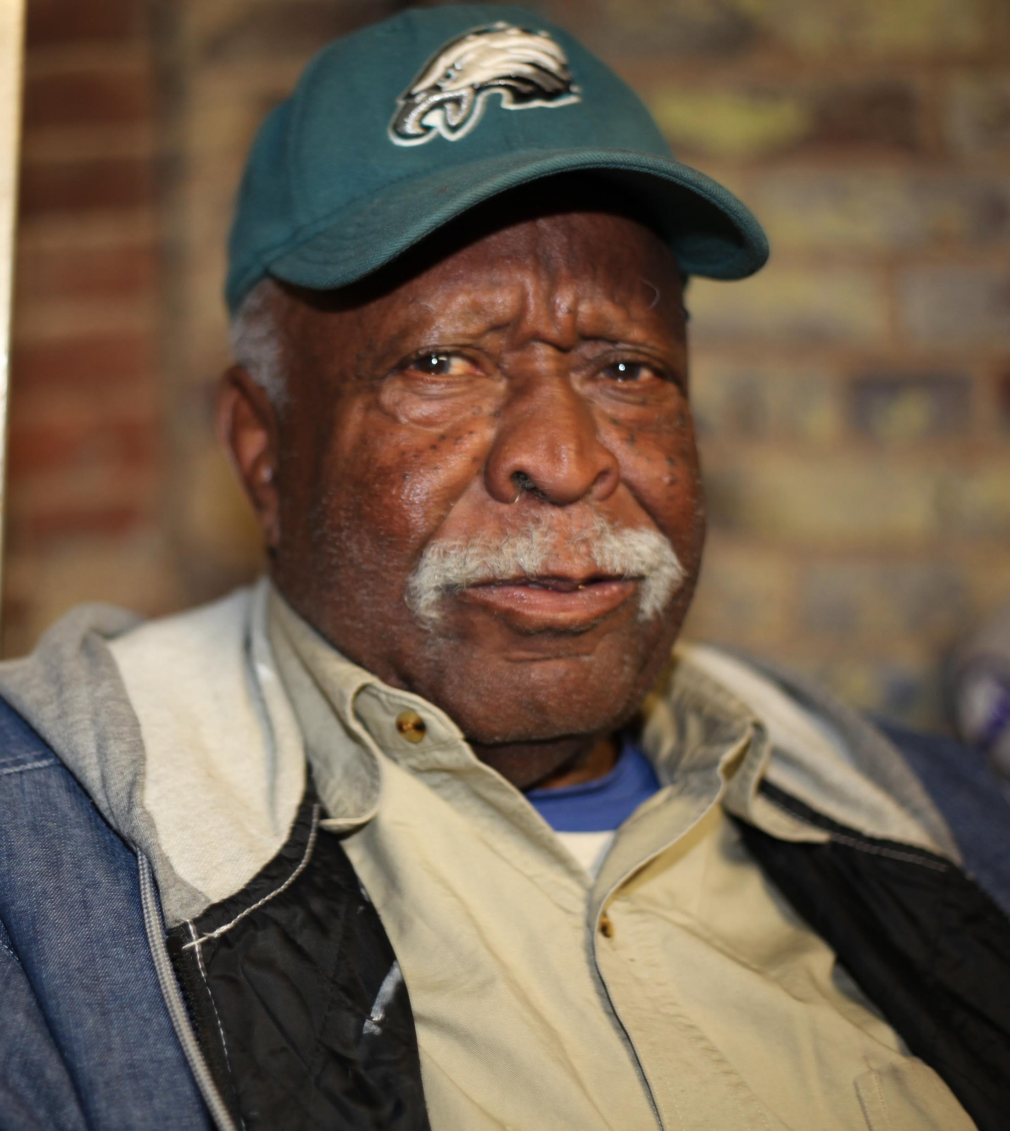
Signs of Abuse
Taunting, emotional stress
Pushing, hitting
Inappropriate or unwanted touching of sexual parts
Mistreating service animals (Section 39.208,F.S.),
Withholding food and medications
Injuries in unlikely places
Burns, bruises
Sudden difficulty walking or sitting
Poor or improper hygiene
Dehydration
Broken bones, sprains, fractures

Slide 10
NEGLECT IS…
The failure or omission on the part of the caregiver to provide the care, supervision, and services necessary to maintain the physical and mental health of the individual such as food, clothing, medicine, shelter, supervision, and medical services, which a prudent person would consider essential for their safety and well-being.
Notes:
Definition in Florida Statute

Slide 11

Signs of Neglect
Leaving individuals unattended with no way to call for help
Leaving individuals in bed all day
Leaving individuals in soiled diapers
Self-neglect (Call 850-300-HOPE for assistance)

Slide 12
EXPLOITATION IS….
A person who stands in a position of trust and confidence with a vulnerable individual and knowingly, by deception or intimidation, obtains or uses, or endeavors to obtain or use, the person’s funds, assets, or property with the intent to temporarily or permanently deprive an individual of the use, benefit, or possession of the funds, assets, or property for the benefit of someone other than the individual.
Notes:
Note: A parent or caregiver who doverts and or misuses money intended for a child’s care would be investigated for child neglect.

Slide 13

Signs of Financial Exploitation
Sudden decrease or change in bank account balances
Sudden problem paying bills or buying food or other necessities
Sudden changes in wills or other financial documents
Notes:
Note: A parent or caregiver who doverts and or misuses money intended for a child’s care would be investigated for child neglect.

Slide 14
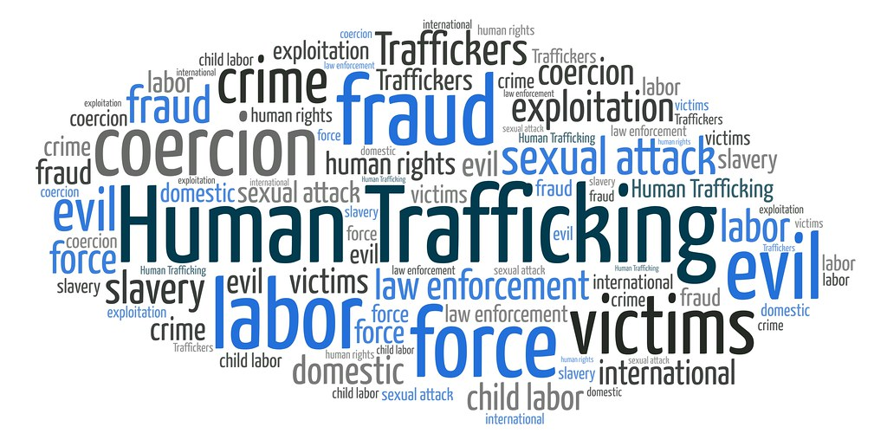
Human Trafficking
Transportation, soliciting, recruiting, harboring, providing, enticing, maintaining, or obtaining another person for the purpose of exploitation of that person.
Florida Statute Chapter 787.06(2)(d)
Notes:
Definition of Human trafficking in Florida Statute

Slide 15


Types of Human Trafficking
LABOR: Agriculture, Begging, Tourism, Nail Salon, Factory Labor
SEX: Prostitution, Brothels, Clubs, Massage Parlors, Escort Services
DOMESTIC SERVITUDE: Nanny, Live-in Maid, Cook, Landscaper, Butler
Notes:
Traffickers do not have one type of profile: They can be Pimps, Intimate partners/family members, Gangs, Criminal networks, Brothel and fake massage business owners and managers, Growers and crew leaders in agriculture, Labor brokers, Employers of domestic servants, Small business owners and managers, Large factory owners and corporations. (APD HT presentation Meghan Torres)

Slide 16
Risk Factors
Some individuals with developmental disabilities are more likely to be victimized because of the perception of a social stigma, inability to assess danger until it is at crisis level, and lack of education. A few examples are:
Unable to report the crime
Not considered credible reporters
May be socially isolated
Lack of economic independence
Dependence on others for long-term care
Unable to differentiate between appropriate and inappropriate touching
Lack of participation in abuse awareness and personal safety programs

Slide 17

Caregiver Risk Factors
Caregiver stress and burnout can be a risk factor for abuse
Caregiver may be experiencing their own personal trauma
Source: Relias LLC, 2023

Slide 18
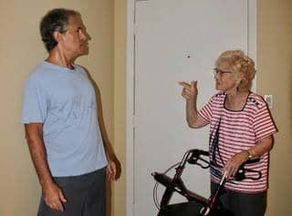
Potential Indicators
Refusing to follow directions or complete necessary personal tasks for dependent person
Using vehicle, money, or other resources without consent
Using threats or menacing looks/body language as a form of intimidation
Speaking for the person with developmental disabilities for attention

Slide 19
THERE IS NO UNIVERSAL RESPONSE TO ABUSE, NEGLECT, OR EXPLOITATION. EVERY INDIVIDUAL RESPONDS DIFFERENTLY AND, IN SOME CASES, THERE MAY BE NO OUTWARD SIGNS AT ALL.

Slide 20
The single most important thing to indicate the possibility of abuse, neglect, or exploitation of a person with a developmental disability is CHANGE.
A sudden or gradual change in behavior, appearance, mood, and sleep patterns should always be noted and monitored.
Abuse Indicators

Slide 21

Your response to a victim should always communicate…
I believe you.
It’s not your fault.
You are not alone.
I want to help you.

Slide 22

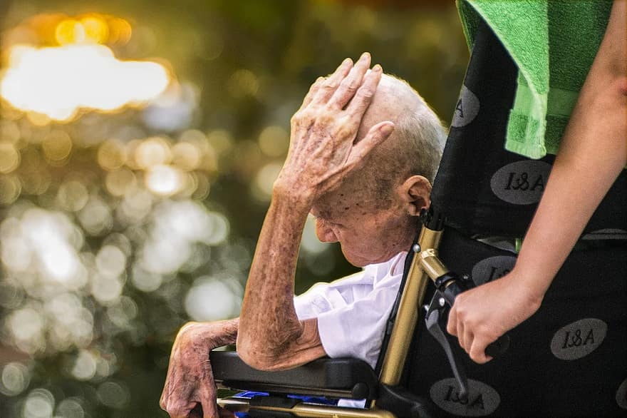
According to a National Statistics report, the rate of violent victimization against persons with disabilities was at least 3.5 times the rate against those without disabilities (per 1,000 people surveyed from ages 12 and older).
Approximately 33% percent of the victims of violent crimes knew their perpetrators.
Source: Bureau of Justice Statistics, National Crime Victimization Survey, 2009-2019. Published November 2021 by NCJ 301367

Slide 23

Children with disabilities, such as physical, developmental, intellectual, emotional, or sensory, are at an increased risk of being bullied.
Source: www.stopbullying.org
Notes:
Source: www.stopbullying.org

Slide 24

Cyberbullying
Occurs on social media platforms, such as Facebook, Instagram, Snapchat, and Twitter
Text message
Instant message
Email
Source: www.stopbullying.org
Notes:
Source: www.stopbullying.org

Slide 25

Prevention Methods
Research shows that the single most effective way to prevent abuse, neglect, exploitation, and sexual misconduct is by providing education and self-protection training directly to individuals with disabilities.
Notes:
Completed

Slide 26
Prevention of Abuse, Neglect, Exploitation, and Sexual Abuse of Individuals with Disabilities
Enhance
Enhance participation within the community to increase visibility in their communities
Recognize and Address
Recognize and address stigma and discrimination that exists
Learn
Learn the signs of abuse, neglect, exploitation, and sexual misconduct
Report
Report suspected abuse, neglect, exploitation, and sexual misconduct to the Florida Abuse Hotline
Engage
Engage with support circles and community members to bring awareness

Slide 27
How Do I Report Abuse, Neglect, and Exploitation?
Fax:
1-800-914-0004
Telephone:
1-800-96-ABUSE (2873)
Telephone Device for Deaf (TDD):
1-800-955-8771
Florida Relay: 711
Online: http://www.dcf.state.fl.us/programs/abuse/
For additional assistance not related to abuse:
1-850-300-HOPE (4673)

Slide 28
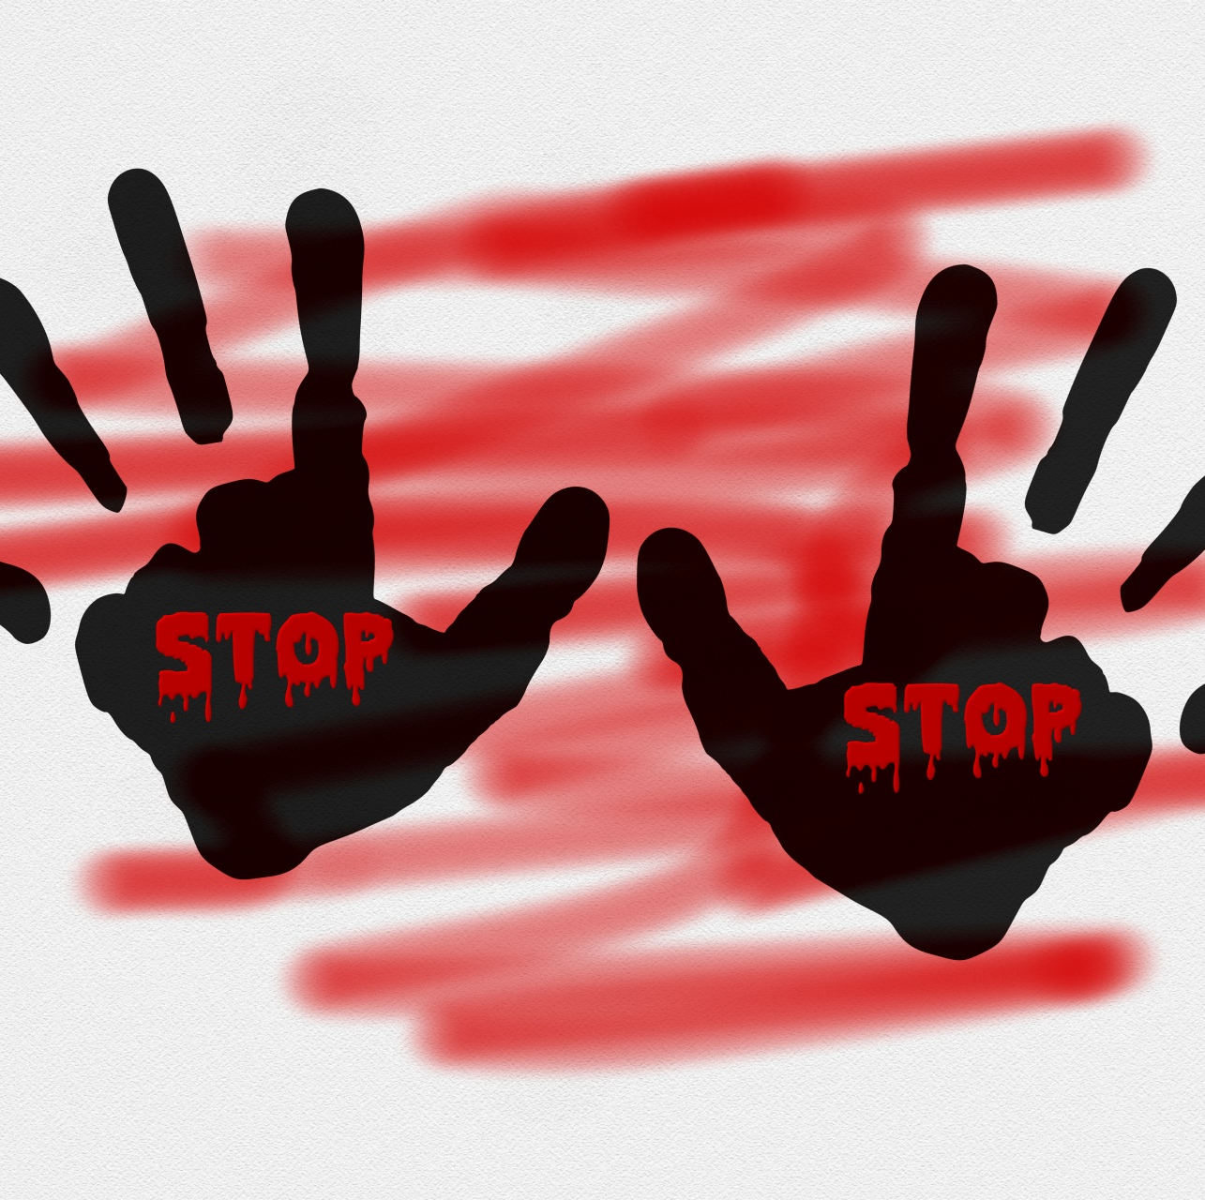
For additional literature and educational trainings, please visit the APD Zero Tolerance website at apd.myflorida.com/zero-tolerance

Slide 29
THANK YOU FOR ATTENDING!
Christy Smiley
Email: Christy.smiley@apdcares.org
Phone: 850-445-4317
Janette Canas
Email: Janette.Canas@apdcares.org
Phone: 850-922-4884
Kari Anderson
Email: Kari.Anderson@apdcares.org
Phone: 850-922-4204

